Slide 1
Evaluating Recommendation System

Slide 2
6.1 Characteristics and properties of evaluation research, Evaluation design goals- Accuracy, Coverage, Confidence and Trust, Novelty, Serendipity, Diversity, Robustness, Stability and Scalability.
6.2 Comparison between evaluation design of classification model and recommendation system, Error metrics, Decision-Support metrics, User-Centered metrics. Comparative analysis between different types of recommendation systems.

Slide 3
A proper design of the evaluation system is crucial in order to obtain an understanding of the effectiveness of various recommendation algorithms. As we will see later in this chapter, the evaluation of recommender systems is often multifaceted, and a single criterion cannot capture many of the goals of the designer. An incorrect design of the experimental evaluation can lead to either gross underestimation or overestimation of the true accuracy of a particular algorithm or model.
online methods
offline methods

Slide 4
Online system
In an online system, the user reactions are measured with respect to the presented recommendations. Therefore, user participation is essential in online systems. For example, in an online evaluation of a news recommender system, one might measure the conversion rate of users clicking on articles that were recommended. Such testing methods are referred to as A/B testing, and they measure the direct impact of the recommender system on the end user.
However, since online evaluations require active user participation, it is often not feasible to use them in benchmarking and research. There are usually significant challenges in gaining access to user conversion data from systems with large-scale user participation. Even if such access is gained, it is usually specific to a single large-scale system.

Slide 5
Offline system
On the other hand, one often desires to use data sets of different types, and from multiple domains. Testing over multiple data sets is particularly important for assuring greater generalization power of the recommender system so that one can be assured that the algorithm works under a variety of settings. In such cases, offline evaluations with historical data sets are used. Offline methods are, by far, the most common methods for evaluating recommender systems from a research and practice perspective.

Slide 6
In particular, the following issues are important from the perspective of designing evaluation methods for recommender systems:
Evaluation goals:
Experimental design issues:
Accuracy metrics:

Slide 7
Evaluation goals
Evaluation goals: While it is tempting to use accuracy metrics for evaluating recommender systems, such an approach can often provide an incomplete picture of the user experience. Although accuracy metrics are arguably the most important components of the evaluation, many secondary goals such as novelty, trust, coverage, and serendipity are important to the user experience. This is because these metrics have important shortand long-term impacts on the conversion rates. Nevertheless, the actual quantification of some of these factors is often quite subjective, and there are often no hard measures to provide a numerical metric

Slide 8
Experimental design issues:
Experimental design issues: Even when accuracy is used as the metric, it is crucial to design the experiments so that the accuracy is not overestimated or underestimated. For example, if the same set of specified ratings is used both for model construction and for accuracy evaluation, then the accuracy will be grossly overestimated. In this context, careful experimental design is important.

Slide 9
Accuracy metrics
Accuracy metrics: In spite of the importance of other secondary measures, accuracy metrics continue to be the single most important component in the evaluation. Recommender systems can be evaluated either in terms of the prediction accuracy of a rating or the accuracy of ranking the items. Therefore, a number of common metrics such as the mean absolute error and mean squared error are used frequently. The evaluation of rankings can be performed with the use of various methods, such as utility-based computations, rank-correlation coefficients, and the receiver operating characteristic curve.

Slide 10
Evaluation Paradigms
User Studies: In user studies, test subjects are actively recruited, and they are asked to interact with the recommender system to perform specific tasks. Feedback can be collected from the user before and after the interaction, and the system also collects information about their interaction with the recommender system

Slide 11
2, Online Evaluation :
Online evaluations also leverage user studies except that the users are often real users in a fully deployed or commercial system. This approach is sometimes less susceptible to bias from the recruitment process, because the users are often directly using the system in the natural course of affairs.

Slide 12
in a news recommender system, one might compute the fraction of times that a user selects a recommended article. If desired, expected costs or profits can be added to the items to make the measurement sensitive to the importance of the item. These methods are also referred to as A/B testing, and they measure the direct impact of the recommender system on the end user. The basic idea in these methods is to compare two algorithms as follows:
1. Segment the users into two groups A and B.
2. Use one algorithm for group A and another algorithm for group B for a period of time, while keeping all other conditions (e.g., selection process of users) across the two groups as similar as possible.
3. At the end of the process, compare the conversion rate (or other payoff metric) of the two groups.

Slide 13
3. Offline Evaluation with Historical Data Sets
In offline testing, historical data, such as ratings, are used. In some cases, temporal information may also be associated with the ratings, such as the time-stamp at which each user has rated the item. A well known example of a historical data set is the Netflix Prize data set [311]. This data set was originally released in the context of an online contest, and has since been used as a standardized benchmark for testing many algorithms. The main advantage of the use of historical data sets is that they do not require access to a large user base. Once a data set has been collected, it can be used as a standardized benchmark to compare various algorithms across a variety of settings. Furthermore, multiple data sets from various domains (e.g., music, movies, news) can be used to test the generalizability of the recommender system

Slide 14
General Goals of Evaluation Design : Accuracy :
Let R be the ratings matrix in which ruj is the known rating of user u for item j. Consider the case where a recommendation algorithm estimates this rating as ˆruj . Then, the entry-specific error of the estimation is given by the quantity euj = ˆruj − ruj . The overall error is computed by averaging the entry-specific errors either in terms of absolute values or in terms of squared values. Furthermore, many systems do not predict ratings; rather they only output rankings of top-k recommended items. This is particularly common in implicit feedback data sets. Different methods are used to evaluate the accuracy of ratings predictions and the accuracy of rankings.

Slide 15
1. Designing the accuracy evaluation: If S is the observed entries in the ratings matrix, then a small subset E ⊂ S is used for evaluation, and the set S − E is used for training. This issue is identical to that encountered in the evaluation of classification algorithms. After all, as discussed in earlier chapters, collaborative filtering is a direct generalization of the classification and regression modeling problem. Therefore, the standard methods that are used in classification and regression modeling, such as hold-out and cross-validation, are also used in the evaluation of recommendation algorithms

Slide 16
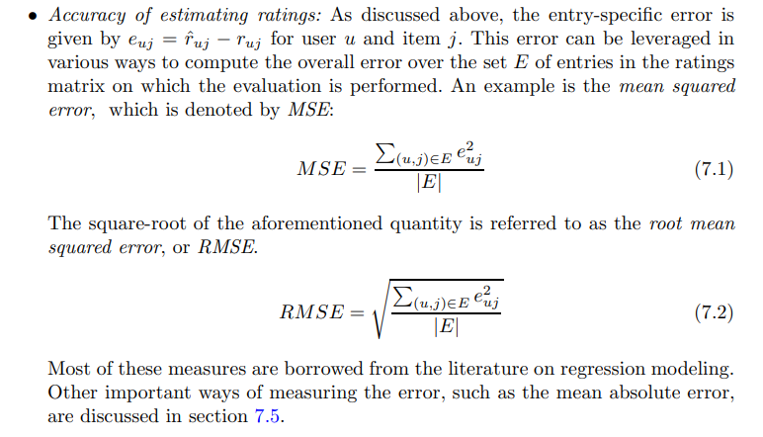
Accuracy metrics: 1

Slide 17
Accuracy metrics: 2
Accuracy of estimating rankings: Many recommender systems do not directly estimate ratings; instead, they provide estimates of the underlying ranks. Depending on the nature of the ground-truth, one can use rank-correlation measures, utility-based measures, or the receiver operating characteristic. The latter two methods are designed for unary (implicit feedback) data sets

Slide 18
Accuracy conclusion
Some measures of accuracy are also designed to maximize the profit for the merchant because all items are not equally important from the perspective of the recommendation process. These metrics incorporate item-specific costs into the computation. The main problem with accuracy metrics is that they often do not measure the true effectiveness of a recommender system in real settings. For example, an obvious recommendation might be accurate, but a user might have eventually bought that item anyway. Therefore, such a recommendation might have little usefulness in terms of improving the conversion rate of the system

Slide 19
Coverage
Even when a recommender system is highly accurate, it may often not be able to ever recommend a certain proportion of the items, or it may not be able to ever recommend to a certain proportion of the users. This measure is referred to as coverage. This limitation of recommender systems is an artifact of the fact that ratings matrices are sparse. For example, in a rating matrix contains a single entry for each row and each column, then no meaningful recommendations can be made by almost any algorithm. Nevertheless, different recommender systems have different levels of propensity in providing coverage.

Slide 20
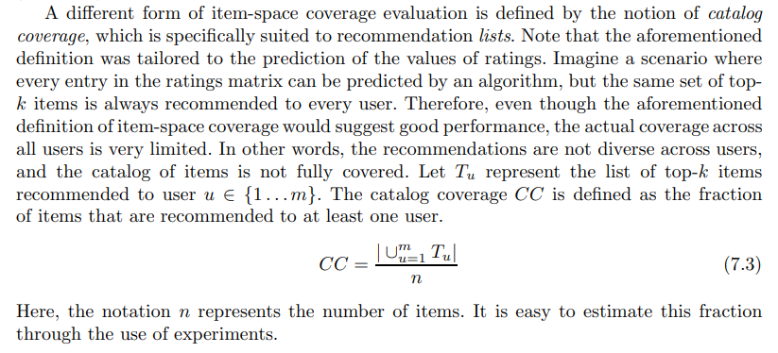

Slide 21
Confidence and Trust
While confidence measures the system’s faith in the recommendation, trust measures the user’s faith in the evaluation.

Slide 22
Novelty
The novelty of a recommender system evaluates the likelihood of a recommender system to give recommendations to the user that they are not aware of, or that they have not seen before. Unseen recommendations often increase the ability of the user to discover important insights into their likes and dislikes that they did not know previously.
The basic idea is that novel systems are better at recommending items that are more likely to be selected by the user in the future, rather than at the present time. Therefore, all ratings that were created after a certain point in time t0 are removed from the training data. Furthermore, some of the ratings occurring before t0 are also removed. The system is then trained with these ratings removed. These removed items are then used for scoring purposes. For each item rated before time t0 and correctly recommended, the novelty evaluation score is penalized. On the other hand, for each item rated after time t0 and correctly recommended, the novelty evaluation score is rewarded. Therefore, this evaluation measures a type of differential accuracy between future and past predictions. In some measures of novelty, it is assumed that popular items are less likely to be novel, and less credit is given for recommending popular items.

Slide 23
Serendipity
The word “serendipity” literally means “lucky discovery.” Therefore, serendipity is a measure of the level of surprise in successful recommendations. Unexpected

Slide 24
Diversity
The notion of diversity implies that the set of proposed recommendations within a single recommended list should be as diverse as possible. For example, consider the case where three movies are recommended to a user in the list of top-3 items. If all three movies are of a particular genre and contain similar actors, then there is little diversity in the recommendations.

Slide 25
Robustness and Stability
A recommender system is stable and robust when the recommendations are not significantly affected in the presence of attacks such as fake ratings or when the patterns in the data evolve significantly over time. In general, significant profit-driven motivations exist for some users to enter fake ratings [158, 329, 393, 444]. For example, the author or publisher of a book might enter fake positive ratings about a book at Amazon.com, or they might enter fake negative ratings about the books of a rival.

Slide 26
Scalability
Big data
Training time: Most recommender systems require a training phase, which is separate from the testing phase. For example, a neighborhood-based collaborative filtering algorithm might require pre-computation of the peer group of a user, and a matrix factorization system requires the determination of the latent factors. The overall time required to train a model is used as one of the measures. In most cases, the training is done offline. Therefore, as long as the training time is of the order of a few hours, it is quite acceptable in most real settings.
2. Prediction time: Once a model has been trained, it is used to determine the top recommendations for a particular customer. It is crucial for the prediction time to be low, because it determines the latency with which the user receives the responses.
3. Memory requirements: When the ratings matrices are large, it is sometimes a challenge to hold the entire matrix in the main memory. In such cases, it is essential to design the algorithm to minimize memory requirements. When the memory requirements beco

Slide 27
Error metrics
If you deal with a graded relevance score, you can employ regression metrics, such as Mean Absolute Error (MAE), Mean Squared Error (MSE), or Root Mean Squared Error (RMSE). They help measure the error between predicted and actual scores.

Slide 28
Decision-Support metrics
Decision support metrics
This is calculated as the number of top k recommendations that are relevant divided by the total number of items recommended. On the other hand, Recall@k (or HitRatio@k) assesses the fraction of top k recommended items that belong to a set of items relevant to the user.

Slide 29
User-Centered metrics
In user-centric evaluation, users interact with a running recommender system and receive recommendations. Measures are collected by asking the user (e.g., through interviews or surveys), observing her behavior during use, or automatically recording interactions and then subjecting system logs to various analyses (e.g., click through, conversion rate). ─
With system-centric methods, the recommender system is evaluated against a prebuilt ground truth dataset of opinions. Users do not interact with the system under test but the evaluation, in terms of accuracy, is based on the comparison between the opinion of users on items as estimated by the recommender system and the judgments previously collected from real users on the same items. Although the user-centric approach is the only one able to truly meas

Slide 30
For hotel choice user centric parameter considered :
─ Choice satisfaction: the subjective evaluation of the reserved hotel in terms of quality/value for the user;
─ Choice risk: the user’s perception of uncertainty and potentially adverse consequences of booking the chosen hotel, measured in terms of the perceived degree of mismatching between the characteristics of the chosen hotel emerging from the use of the system and the real characteristic of the accommodation;
─ Perceived time: the user’s judgment on the length of the decision making process;
─ Elapsed time: the time taken for the user to search for hotel information and make a reservation decision;
─ Extent of hotel search: the number of hotels that have been searched, for which detailed information has been acquired;
─ Number of sorting changes: the number of times the user changed the ordering of hotels in the list view:

Slide 31
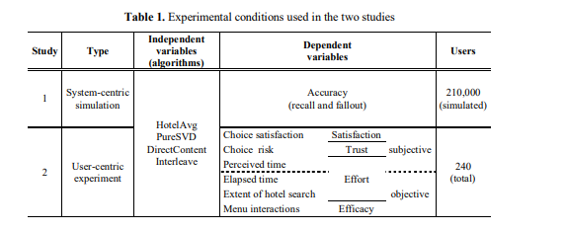

Slide 32
Comparison between evaluation design of classification model and recommendation system,

Slide 33
Comparative analysis between different types of recommendation systems.

